Slide 1

Presentation title
Presenter Name
Institute of Informatics & Telecommunications
NCSR Demokritos

Slide 2
let’s meet
1
2
expertise
innovation & services
3
4
wrap up

Slide 3
1
let’s meet
about us | vision & mission

Slide 4

SKEL Lab stands for Software and Knowledge Engineering Laboratory
Created more than 30 years ago in 1989
SKEL is part of the Institute of Informatics & Telecommunications at the National Centre for Scientific Research Demokritos the biggest interdisciplinary research centre in Greece
Capitalizes on important computer and network infrastructure
Invests heavily and leads cutting-edge R&D activities focused on Artificial Intelligence (AI), Data Science, Robotics and Natural Language Processing (NLP)
Concentrates on application domains: health, culture, security, news and media, smart cities
Leader in the higher education landscape, participating in cross-institutional MSc programs, establishing joint PhD programs, organising seminars and summer schools
1
let’s meet
about us

Slide 5
Research Groups
CAKT | Content Analysis and Knowledge Technologies
CER | Complex Event Recognition
DEG | Data Engineering Group
RoboSKEL | Robotics Activity
DICE | Artificial Intelligence Center of Excellence on Document Intelligence
ID-IS | Intelligent
Data-Intensive Systems

Slide 6
Research Teams
BioHIT | Biomedical and Health Informatics Team
AHEDD | the Attica Digital Innovation Hub for the Economy of Data & Devices
Artif@ct | Artificial Intelligence for Culture

Slide 7
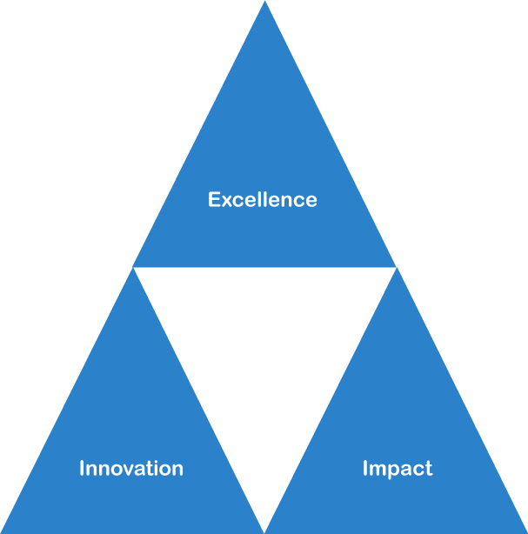
SKEL VISION
Putting Technology/AI to work for the greater good of society and the environment whilst helping the Industry to advance
SKEL MISSION
Our Mission is to help Technology/AI advance scientifically & transfer this knowledge to Industry which
will feed back to society
1
let’s meet
vision & mission

Slide 8
2
expertise

Slide 9
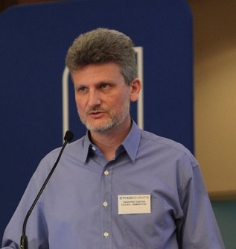
Dr. George Paliouras
Head of Lab
With more than 110 staff, SKEL has a wide skillset
50+ Researchers
20+ Research Projects in progress
Innovation - Patents - Services
Successful international collaborations | EY /DICE
2
expertise

Slide 10
Investing heavily on research around Artificial Intelligence, Data Science
Concentrating on application domains: health, culture, security, news and media, smart cities, document intelligence
2
expertise

Slide 11
innovation & services
3

Slide 12
Close ties with industrial stakeholders
Lefkippos Technology Park - Innovative start-ups & spinoffs
Services provided – ahedd DIH
3
innovation & services

Slide 13
wrap up
4

Slide 14
Presenter name
email personal webpage
feel free to contact us!

